Slide 1
Develop Software Solutions to EnhanceEducational Infrastructure and Connectivity in Rural Areas
PSCS_367
Review-3
Batch Number: CDV-G13
Under the Supervision of,
Dr./Mr./Ms./Prof. : Shankar j
Professor / Associate Professor / Assistant Professor
School of Computer Science and Engineering
Presidency University
Name Student ID
Shaik Thaheer 20211CDV0002
Abdul Manan 20211CDV0009
Md Kaif 20211CDV0003
Keerthi Kumar 20211CDV0008
Name of the Program: University Project(PSCS-367)
Name of the HoD: Dr. Pravinth raja
Name of the Program Project Coordinator: Suma Gowda
Name of the School Project Coordinators: Dr. Sampath A K / Dr. Abdul Khadar A / Mr. Md Ziaur Rahman

Slide 2
Introduction
Education plays a crucial role in shaping the future of individuals and communities. However, rural areas often face significant challenges in accessing quality education due to a lack of infrastructure, trained educators, and digital resources. With advancements in technology, software solutions have the potential to bridge this gap by providing innovative tools to enhance learning experiences and improve connectivity. This project aims to develop a comprehensive software solution that supports digital learning, enables better communication between teachers and students, and enhances educational accessibility in rural regions. By leveraging cloud-based platforms, AI-driven learning systems, and scalable connectivity solutions, we intend to create an inclusive and sustainable educational ecosystem. The ultimate goal is to empower students and educators with the necessary resources to improve learning outcomes and foster long-term educational growth in underserved communities.

Slide 3
Literature Review
Challenges in Rural Education – Limited infrastructure, lack of trained teachers, and poor digital access hinder learning opportunities (UNESCO, 2021).
Digital Learning Benefits – Online platforms and AI-driven personalized learning improve flexibility and engagement (Anderson & Dron, 2011).
Technology as a Solution – Cloud-based platforms and mobile learning enhance accessibility, especially in developing regions (Aljawarneh, 2020).
Connectivity Barriers – Over 30% of rural areas lack reliable internet; solutions include satellite-based internet and offline learning apps (ITU, 2022).
Need for Sustainable Models – Government programs like "Digital India" help, but scalable solutions, teacher training, and long-term funding are essential for success (McKinsey, 2021).

Slide 4
Existing method Drawback
Traditional Schools – Lack of qualified teachers and outdated learning materials reduce education quality.
Government E-Learning Programs – Poor internet access and low digital literacy limit their effectiveness.
Online Learning Platforms – Require stable internet, which is not available in most rural areas.
Mobile-Based Education Apps – Many rural students lack smartphones, and high data costs restrict usage.
Broadcast-Based Learning (TV/Radio) – One-way communication lacks interaction and engagement.
Community Learning Centers – Limited reach, infrastructure issues, and dependency on funding.
Satellite Internet Solutions – Expensive to implement and maintain, making scalability difficult.

Slide 5
Proposed Method
Cloud-Based E-Learning Platform
AI-Driven Personalized Learning
Offline Learning Support
Mobile & Web-Based Accessibility
Teacher Training & Digital Literacy Programs
Low-Cost Internet & Network Solution
Smart Classrooms & Digital Libraries
Public-Private Partnerships
Community-Based Learning Support

Slide 6
Objectives
Improve Access to Education – Provide digital learning solutions for rural students.
Enhance Internet Connectivity – Develop affordable and offline learning options.
Personalized Learning Experience – Use AI to tailor content for individual students.
Empower Teachers – Train educators to integrate digital tools into teaching.
Promote Digital Literacy – Educate students and teachers on using technology effectively.
Develop Cost-Effective Solutions – Utilize cloud-based and mobile-friendly platforms.
Encourage Public-Private Collaboration – Partner with NGOs and governments for scalability.

Slide 7
Methodology/Modules
Requirement Gathering and Analysis
System Design & Architecture
Development Modules
E-Learning Platform
AI-Based Personalized Learning
Offline Learning & Content Syncing
Teacher Training & Digital Resources
Connectivity Enhancement
Testing & Deployment
Monitoring & Continuous Improvement

Slide 8
Hardware/software components
Technology Stack Components:
Front end: Html, CSS, JavaScript, ReactJs,
Back end: Python, Django
Database: Db.sqlite3

Slide 9
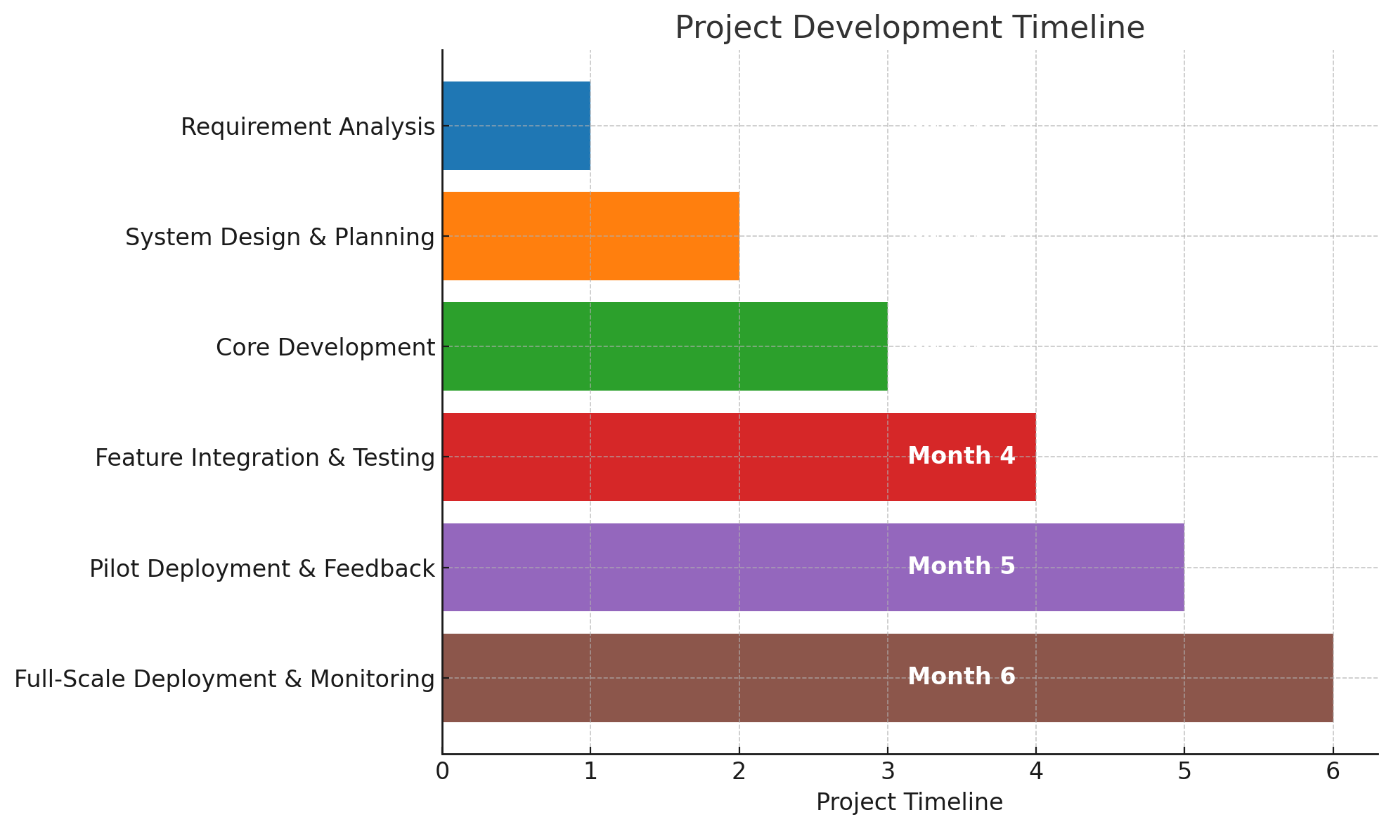
Timeline of the Project (Gantt Chart)

Slide 10
Expected Outcomes
Increased Access to Quality Education
Enhanced Connectivity in Remote Areas
Personalized Learning Experience
Empowered Teachers & Digital Literacy
Improved Student Performance
Scalable & Sustainable Solution
Community Engagement & Awareness
Real-Time Performance Tracking
Bridging the Digital Divide

Slide 11
Conclusion
Education is the key to empowerment, but many rural students still struggle with limited access to quality learning resources. This project aims to bridge that gap by using technology-driven solutions to make education more accessible, engaging, and effective.By introducing AI-powered personalized learning, offline study options, and digital teacher training, we can create a flexible and inclusive system that meets the unique needs of rural communities. Affordable internet solutions and mobile-friendly platforms will further ensure that students, regardless of location, can continue learning without barriers.
More than just a technological initiative, this project is a step toward building a brighter future for rural students. Through collaborations with governments, NGOs, and local communities, we can make education not just a privilege but a right for everyone. By embracing innovation, we are not only improving learning outcomes but also shaping a generation ready for tomorrow’s challenges.

Slide 12
Github Link
The Github link provided should have public access permission.
GitHub LInk

Slide 13
References
[1] World Bank, “Digital Technologies in Education: How Technology Can Support Teaching and Learning in Developing Regions”, World Bank Report, Pp. 1-45, 2022.
[2] UNESCO, “The Role of ICT in Education: Transforming Learning in Rural Areas”, Journal of Educational Technology and Development, Vol. 5, No. 2, pp. 23-37, 2021.
[3] Ministry of Education, Government of India, “DIKSHA – Digital Infrastructure for Knowledge Sharing”, National Education Policy, Pp. 12-27, 2020.
[4] R. Luckin, “Artificial Intelligence in Education: Personalized Learning and Student Engagement”, in International Conference on Learning Technologies, Springer Berlin Heidelberg, pp. 55-68, 2018.
[5] ITU (International Telecommunication Union), “Challenges of Rural Connectivity and Internet Access”, ITU Technical Report, Pp. 101-126, 2019.
[6] K. Davidson, L. Peters, and J. Wang, “E-Learning Platforms and Their Impact on Rural Education”, Journal of Online Learning and Teaching, Vol. 9, No. 4, pp. 45-62, 2017.
[7] Pratham, “Annual Status of Education Report (ASER)”, in Educational Development Studies, Vol. 16, No. 1, Pp. 7-19, 2022.
[8] N. Selwyn, “Education and Technology: Key Issues and Debates”, Oxford University Press, Pp. 88-110, 2011.
[9] M. K. Sinha, R. Gupta, and P. Verma, “EdTech Solutions for Bridging the Digital Divide”, Journal of Digital Learning and Innovation, Vol. 11, No. 3, Pp. 189-205, 2020.
[10] Pew Research Center, “The Growth of Digital Learning: Adoption and Future Trends”, Pew Research Reports, Pp. 55-78, 2023

Slide 14
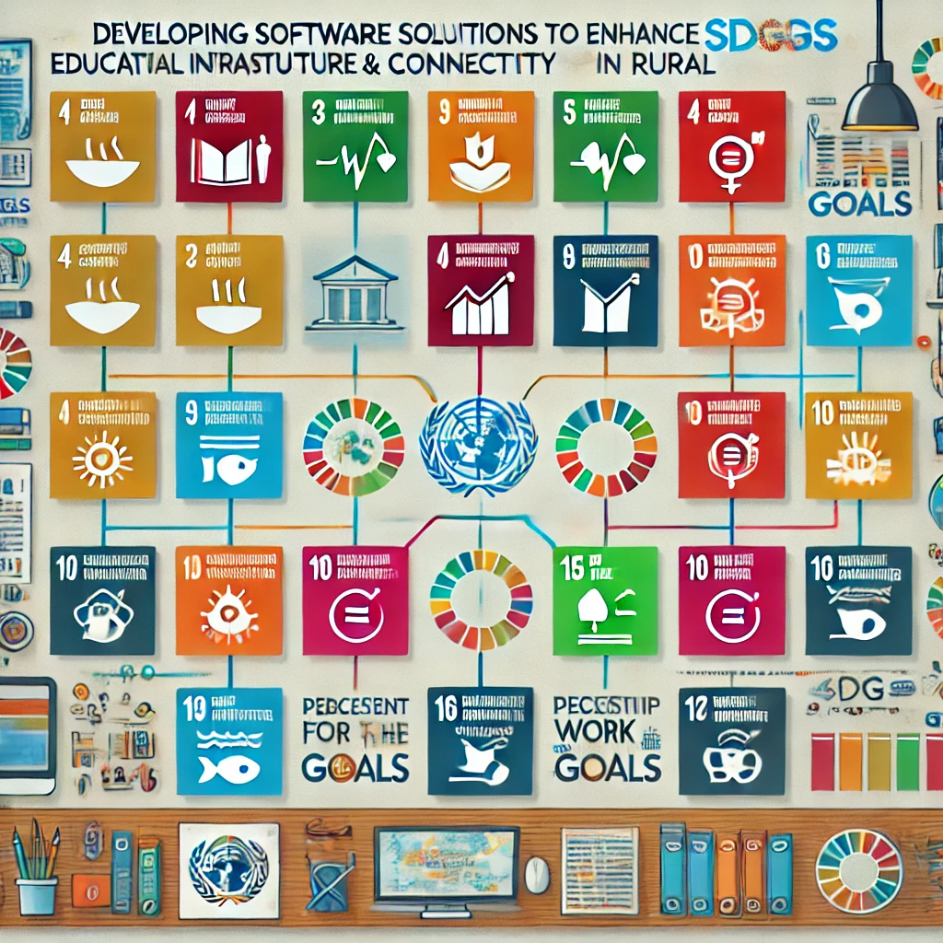
Project work mapping with SDG

Slide 15
Thank You

